Slide 1
Topic 3: AI-Powered Ad Creatives Generation and Campaign
Parth Patel, Tanmaya Hada, Ricky Guo, Albert Stanley, Pranav Balgi

Slide 2
Introduction
Manually creating ads and selecting the best one is a timely and costly approach.
Problem:
A single ad may not work in all target markets
Example: regional differences, special occasions
Solution:
Use a controlled feedback loop
Utilize AI/ML techniques to generate images
Based on metrics, adapt the image that did best and send it for delivery
Notes:
The process of creating and choose an ad is a timely and costly process. There’s many factors to consider and approval needed along with testing before the ad is sent for delivery to the audience. For example, one problem is that a single ad will not work in all markets due to regional differences.
Our approach is to use a controlled feedback loop that utilizes AI/ML techniques to generate and adapt images.

Slide 3
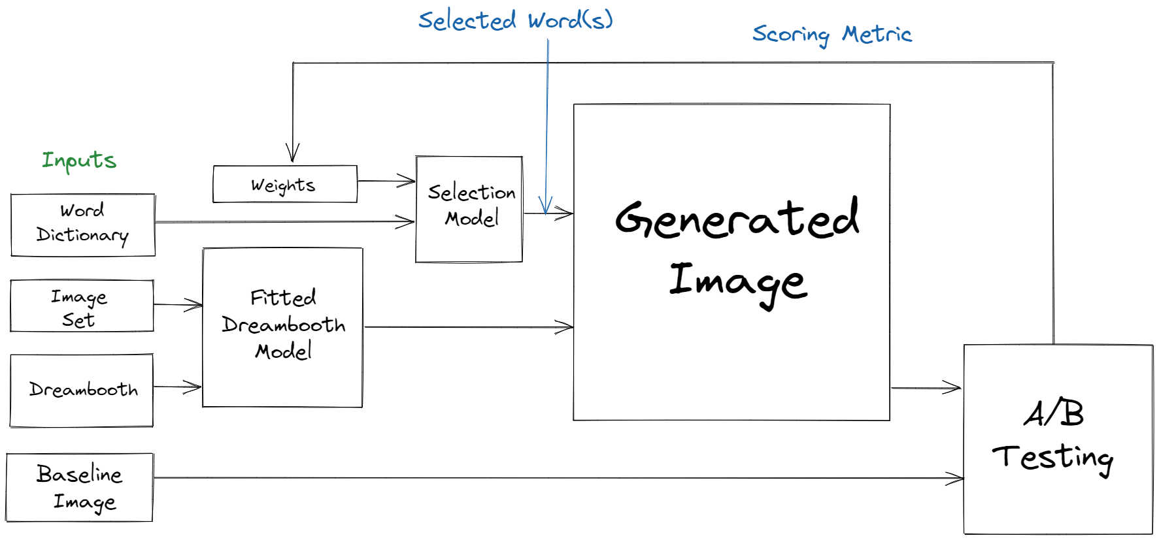
Feedback Loop Diagram

Slide 4


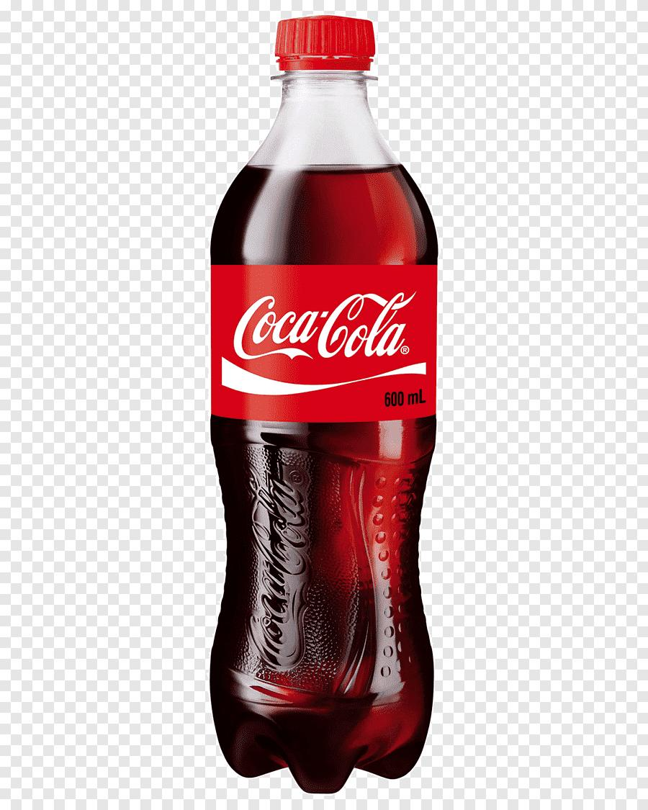
Data Collection
Leverage existing platforms’ API and data-scraping to decide what images would be the most appropriate to use.
Use phrases and words associated with the brands/objects parsed from the internet.
Crisp and refreshing
Dreambooth
Notes:
The first step is data collection. We leverage existing platforms to obtain the necessary data. For example, we use Google Image and other search engines to download the most relevant images and sources like Wikipedia to obtain key phrases and words that describe the product or brand.

Slide 5
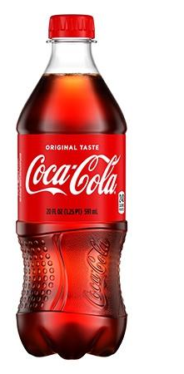
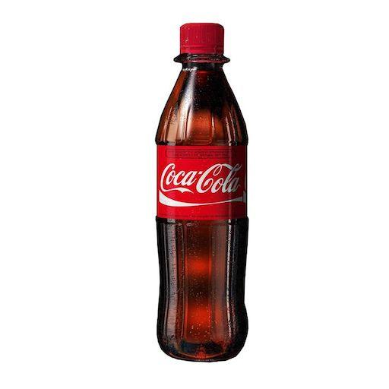
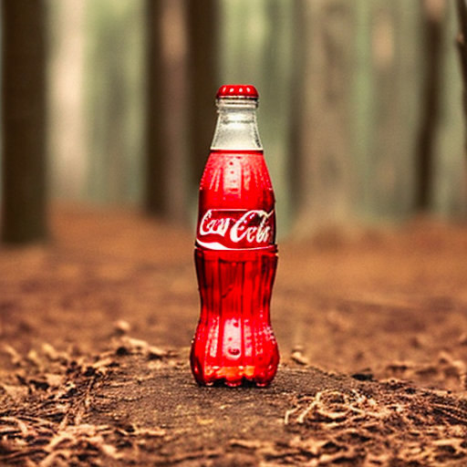
Dreambooth
Training Images
Used implementation based on stable diffusion
Fine tuned stable diffusion on a few example products:
Coca-Cola bottle
pepperoni pizza
Deployed model on AWS EC2 Instance to provide API for inference
dreambooth/?query=”a pepperoni pizza”
Returns image generated by the fine-tuned diffusion model
Inference After Fine-Tuning
Query
coke soda bottle in the forest
Fine-Tuned Stable Diffusion Model

Slide 6
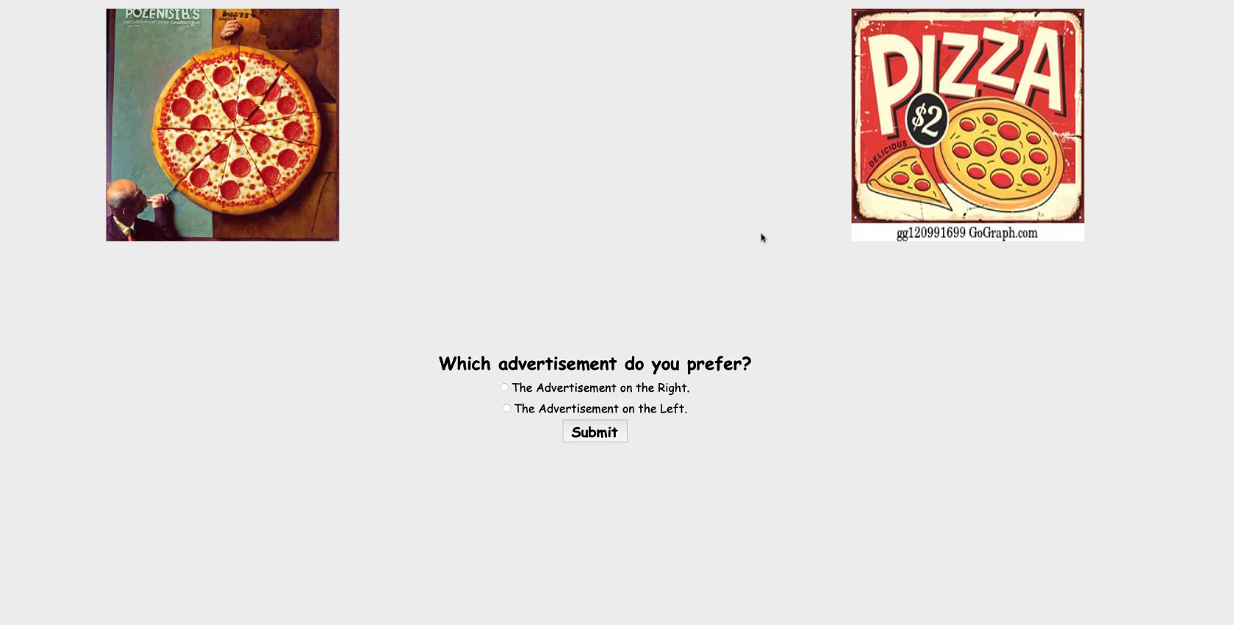
A/B Testing
Goal: Create an advertisement image that maximizes engagement with users.
Metrics
Impressions, Reach, etc.
Clicks.
Simulation
[Proxy] Which advertisement does the user prefer?
Most likely to generate a click.
[Head-to-Head comparison] Generated advertisement image must be better than the existing one to make sense to show to begin with.
Notes:
For the A/B Testing component, it’s important to first recall that our goal is to generate an advertisement that maximizes engagement with users. To that end, we want to optimize for some metric that best captures user engagement. The problem with traditional metrics like impressions and reach is that they’re a product of the ad engine and we cannot emulate this locally so we chose to find a proxy for clicks. We simulate this with a prompt that can be seen on the right of this slide and use head to head comparisons against a baseline. The baseline can be thought of as the deployed ad which we want to make sure our generated ad can beat. If our generated ad can’t beat the existing ad it won’t make commercial sense to actually use the generated ad.

Slide 7
Selection Model
Goal: select best prompts to generate ads for the next round of AB testing
Score Prediction Model
predicts AB test score of the ad generated by a prompt
uses word2vec cosine similarity
Input Generation
randomly generate untested prompts
select best prompts (highest predicted score) to use for the next round

Slide 8
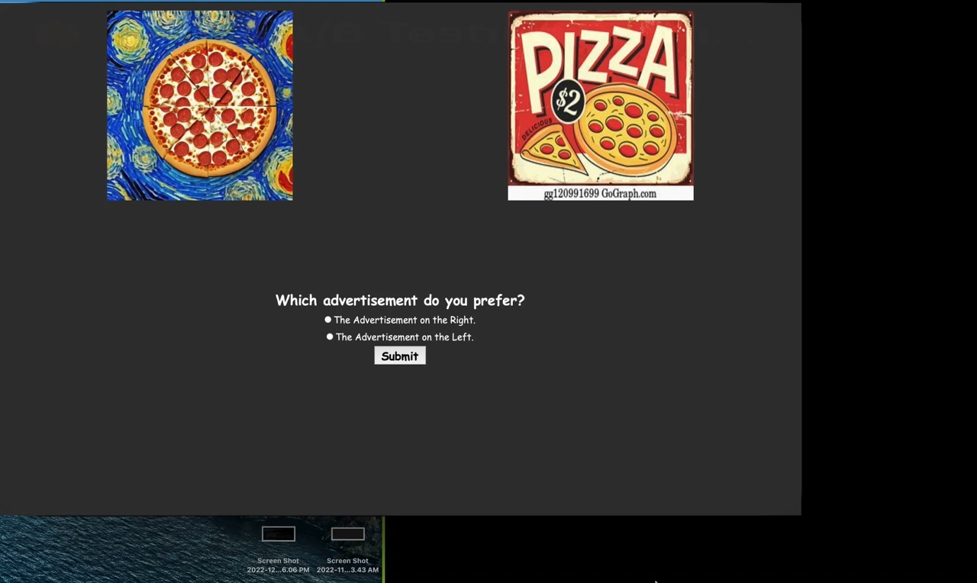

Slide 9
Conclusions
Takeaway
Using AI/ML in a feedback loop shows results
Easy to adapt based on key features and metrics
Future work
Test on a larger region using professional ad services
Expand metrics to include what features of the images maximized user interaction rather than the image as a whole
Train our own selection model

Slide 10
Questions?

